Slide 1
HVAC/R -> Middle TN Team Meeting -> Dec. 2024
Refrigerants update and more

Slide 2
Annual (or bi-annual) team meeting
Target historical shoulder seasons and discuss state of current affairs
Changes in the industry
Rules and regulations
Manufacturers and product related
Changes within Evolution
New processes or procedures internal to our company
New processes or procedures as they relate to our customers
Community/team
Get to know each other better and appreciate the work we do
Welcome in new members to the team

Slide 3
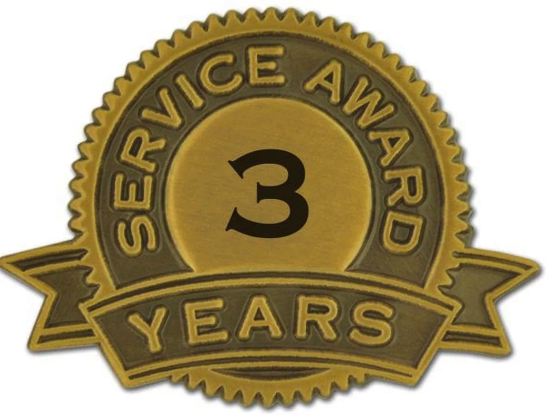
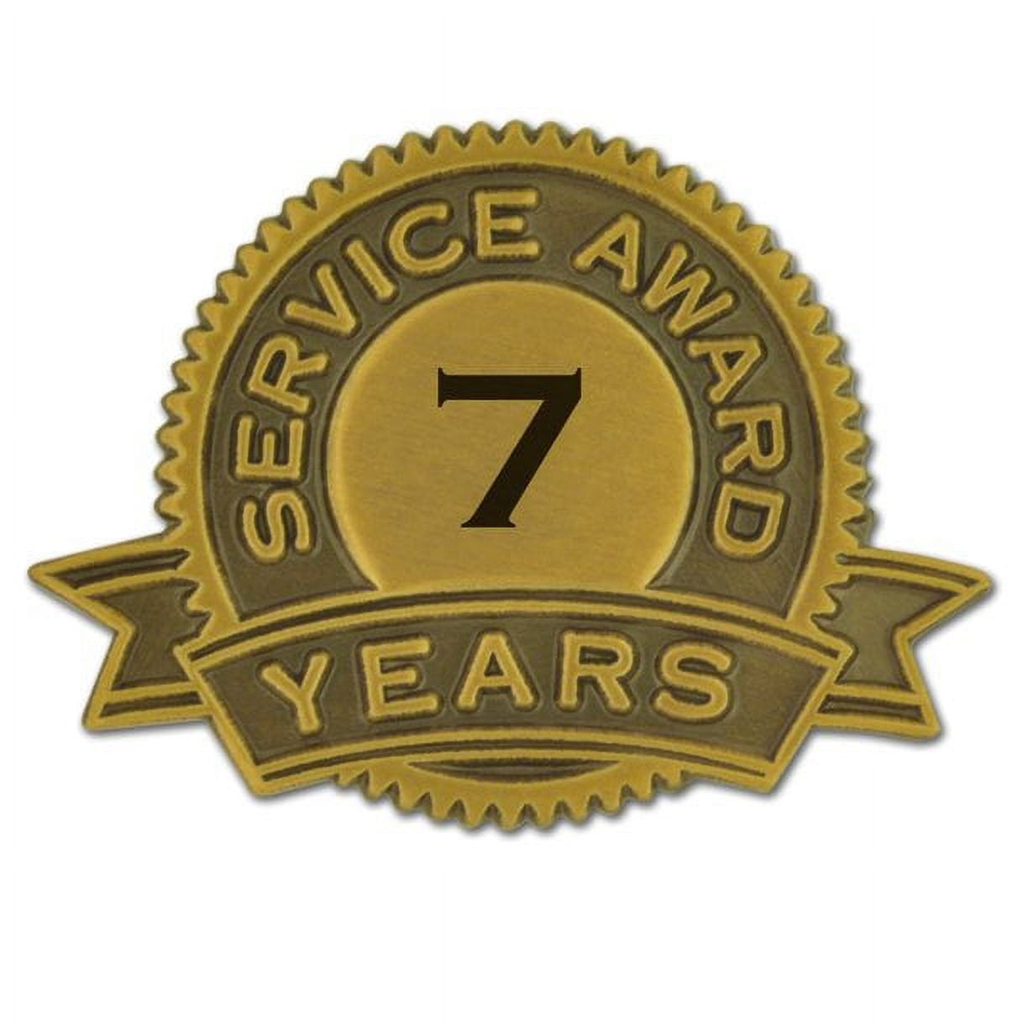
Meet the Team
Junior
Garcia
Leon
Osbourne
John Romeo
Sam Tummons
Dave Ross
Mike
Miller
Marquis Wheeler
Ayman
Abdulshaheed
William
Bourland
Blaike Allen

Slide 4
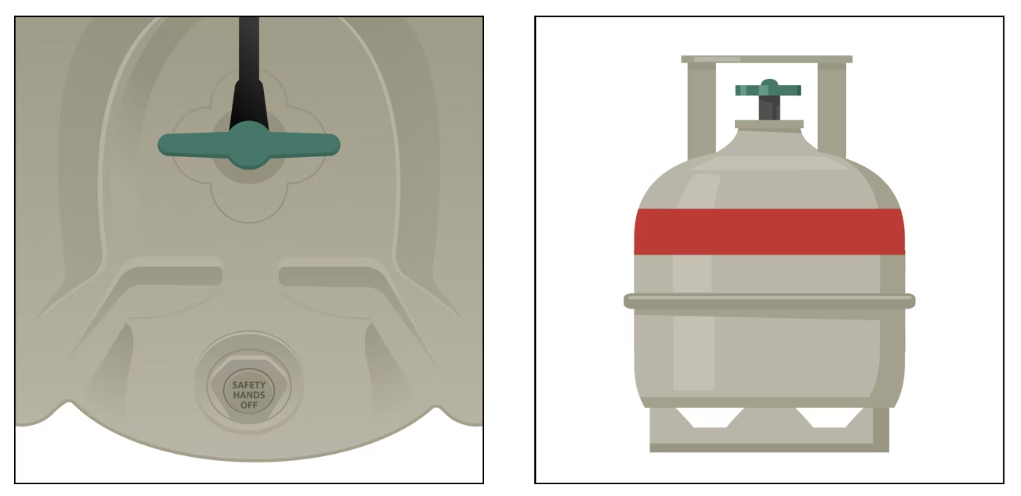
What is A2L?
A = non-toxic, 2 = flammable, L = low burning velocity
A2L refrigerants are being phased in to replace higher impact GWP (global warming potential) HFC refrigerants like 410A.
Distinct characteristics of A2L cylinders:
Light gray in color with red band at top
Have pressure relief valve instead of a rupture disk
Use left-handed threading (must use specific A2L connectors)

Slide 5
Refrigerant Background and History
Refrigerant changes – timeline (through 7:10)
GWP – Global warming potential
Moving forward, regulations will aim toward 500 or lower GWP; 454B meets this criteria
GWP has an inverse relationship with flammability -> as we lower GWP, flammability goes up
Mandate is targeting 85% reduction by 2036
Manufacturing of 410A systems banned – January 1, 2025
Previously manufactured units can be installed through January 1, 2026
R22 and 410A will be available for many years for currently operable HVAC/R

Slide 6
Hazards of A2L Refrigerants??
https://www.youtube.com/playlist?list=PLSxd3idSC2RZGfART6HZEIa_Zy3vJr39K
https://www.youtube.com/watch?v=KUFEwg7ADug (1:10 and 4:30)
https://www.youtube.com/watch?v=UrQP24rTIsU (until 2:45)

Slide 7
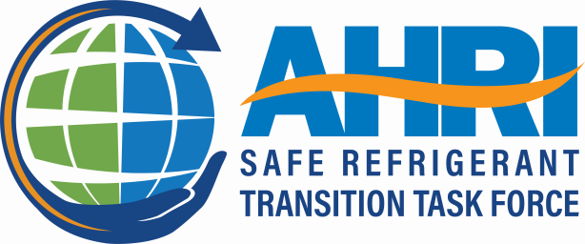
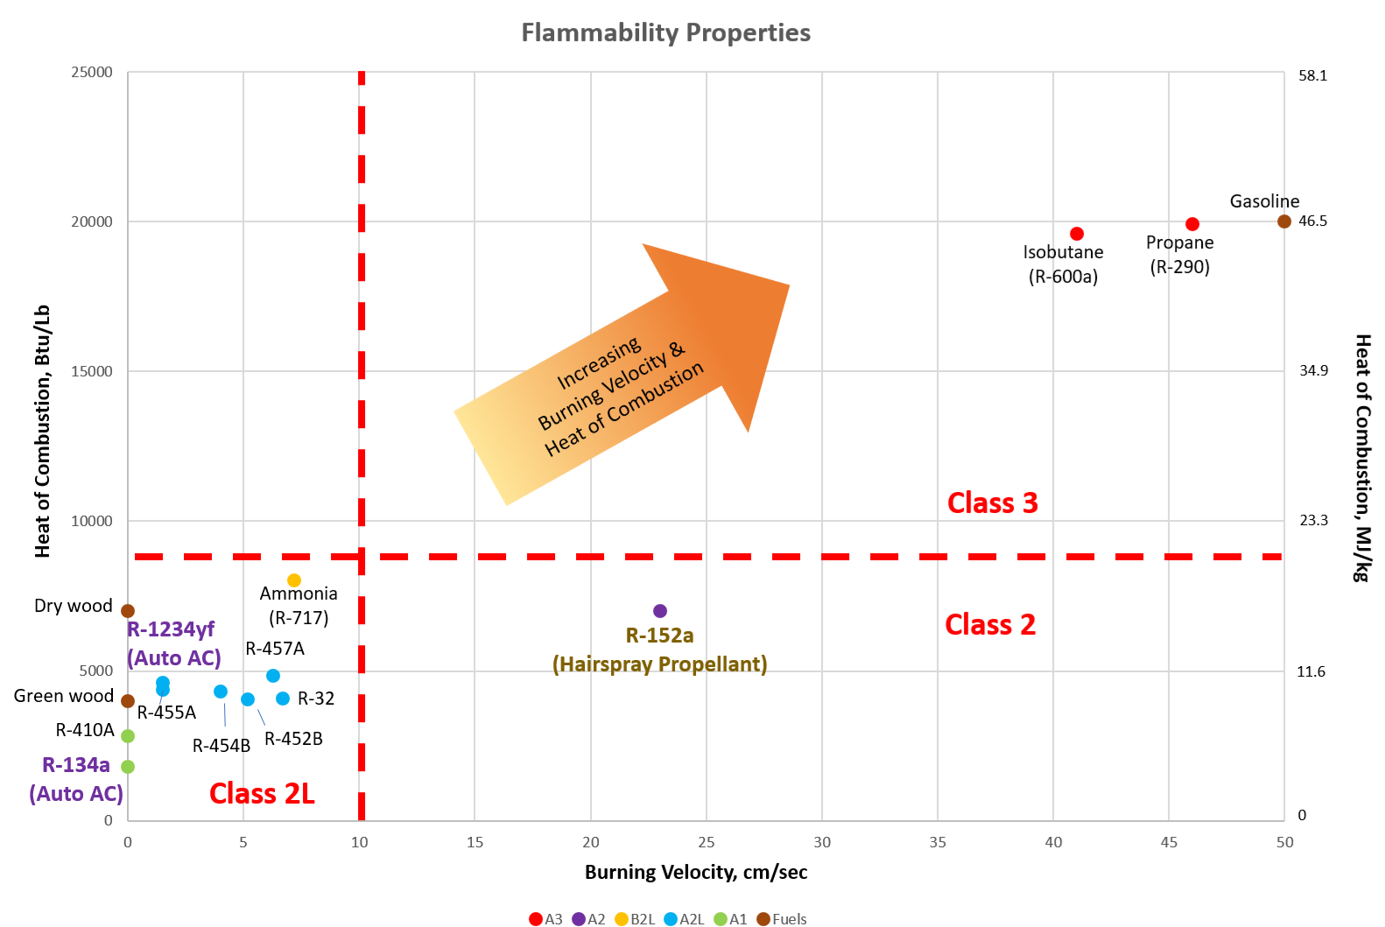

Slide 8
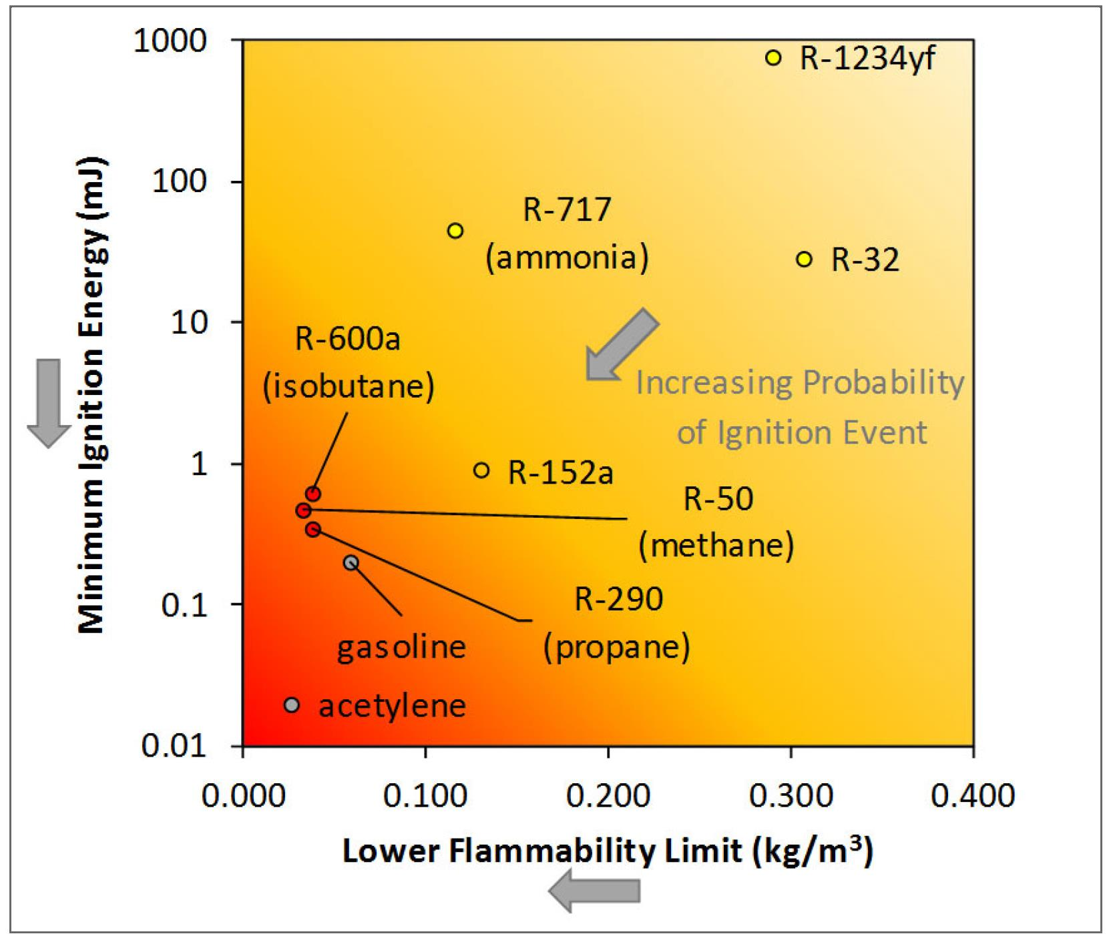
Flammability – Minimum Ignition Energy (MIE)
Hydrocarbons require relatively low energy levels to ignite
MIEs of A2Ls are much higher than hydrocarbons
Many potential ignition sources for hydrocarbons (e.g., static spark) will not ignite A2Ls
Many common household items (toasters, electric heaters, etc.) will not ignite A2Ls

Slide 9
System Adjustments for A2L
Mitigation is achieved through a combination of OEM system design changes
ignition source protection
refrigerant detectors installed in the product
charge size, enhanced system tightness and leak detection
piping design and testing requirements, appropriate standards and codes for various applications

Slide 10
More About A2Ls
• Most of the basic chemical/physical properties of next-generation refrigerants are very similar to previous generation (CFC/HCFC/HFC).
Many new refrigerants are blends that are currently part of Class A1 refrigerant blends (e.g., R-410A is 50% R-32, a Class A2L refrigerant)
• Compared to propane and natural gas, A2L refrigerants have much lower flammability risk due to:
Higher Lower Flammability Limit –> Higher concentration to become flammable
Higher Minimum Ignition Energy (MIE) –> harder to ignite
Lower Heat of Combustion –> less energy released if burned
Lower Burning Velocity –> more difficult for flames to spread
• Class A2L refrigerants are already being used safely -> Global auto industry (including U.S. and Canada) -> Air conditioning and refrigeration equipment in the European Union, Australia, Japan, Thailand and other countries -> Small appliances as approved by the Environmental Protection Agency (EPA)

Slide 11
What does it all mean for you?
Safety first
PPE (fire extinguisher, safety glasses)
Proper tools and gauges (A2L compatible)
Pay mind to the simple things
Don’t be distracted while working on the unit
Step away from the unit to take a call or call back after you complete what you are working on
Don’t be complacent. Approach with more caution because this is new to us
Follow all protocols
As new developments unfold, we will work to update the team

Slide 12
Service Best Practices
Follow typical refrigerant management best practices and be aware of new safety considerations:
which A2L refrigerant is being used?
check for refrigerant labels and red markings/stickers on the system
clearly mark them for the next technician who may service the system.
Use A2L approved gauges, thread adapters, vacuum pumps, and leak detection and refrigerant recovery machines. When servicing or repairing A2L systems, follow 3 mandatory steps (which are already considered industry-accepted best practices):
Purge with nitrogen.
Evacuate the refrigerant.
Perform leak and pressure tests.

Slide 13
Servicing A2L Units (continued)
Cut don’t unsweat to avoid potential issues with open flame
Pull vacuum properly to avoid excess oxygen in line
Never attempt to put A2L refrigerant in previous HVAC/R system
Remember, this stuff isn’t scary -> follow your standard processes and proceed with caution and you will have no issues.

Slide 14
What are you seeing?

